Slide 1

Module 3 –In Memory Computation
Getting started with Spark

Slide 2
IN MEMORY COMPUTATION
Contents
Overview of this Module
Scala | Spotting the differences between Java and Scala
Spark | In Memory Computation, Architecture, Scheduling, RDD, Data Frames
PySpark and Handson | Architecture and writing spark program in Python, Page rank in Spark
Complexity | Choosing an ideal Algorithm

Slide 3

IN MEMORY COMPUTATION
My Flow of explanation
Slightly Different Approach
Reasons
Hot technology for handling massive datasets
Getting exposed to massive magnitude is vital
One million movie ratings and run it in amazon Elastic Map Reduce service

Slide 4
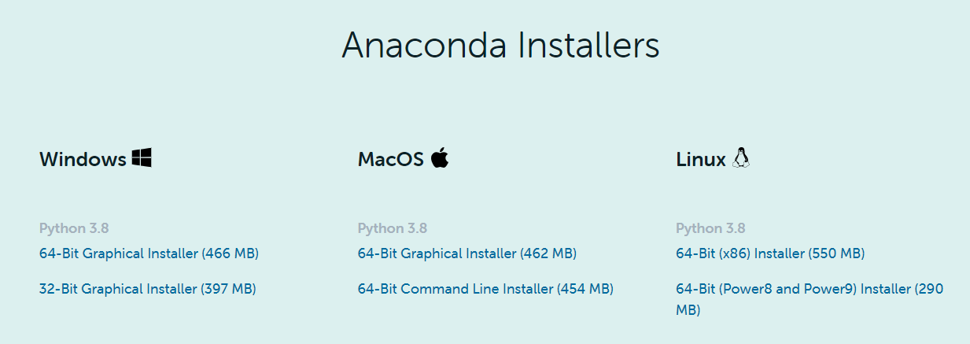
IN MEMORY COMPUTATION
Setting up the Environment
Step 1:

Slide 5
IN MEMORY COMPUTATION
Setting up the Environment
Step 2: Java Development Toolkit
Spark runs on Scala and Scala runs on top of Java Run time Environment
Download and install JDK 8

Slide 6
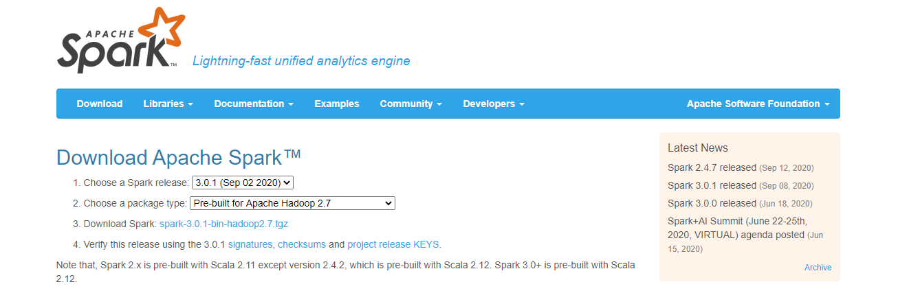
IN MEMORY COMPUTATION
Setting up the Environment
Step 3: Install Spark

Slide 7
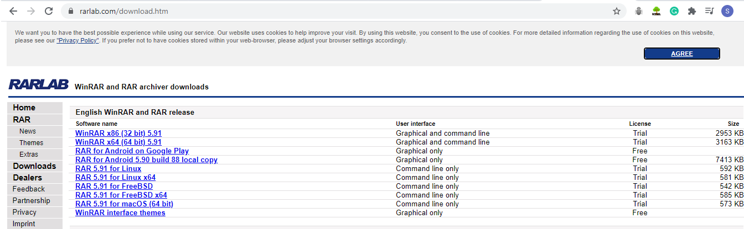
IN MEMORY COMPUTATION
Setting up the Environment

Slide 8
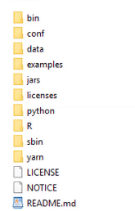
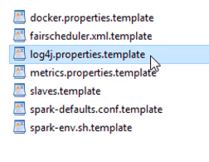
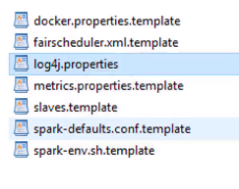
IN MEMORY COMPUTATION
Setting up the Environment
Step 4: Extract the contents
Create a folder Spark in C drive and copy these contents

Slide 9
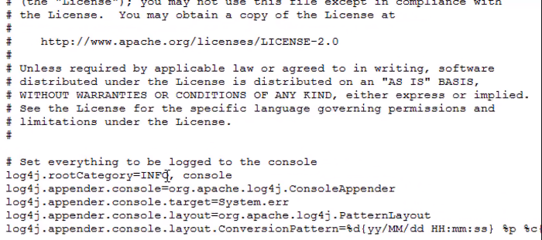
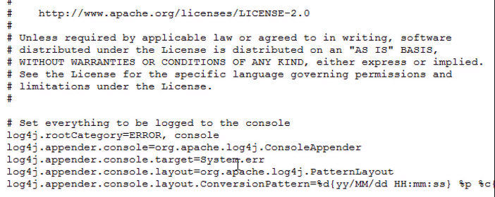
IN MEMORY COMPUTATION
Setting up the Environment

Slide 10
IN MEMORY COMPUTATION
Setting up the Environment
Utility exe is available in Edmodo

Slide 11
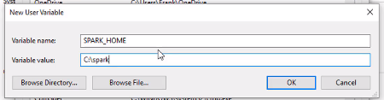
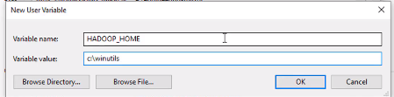
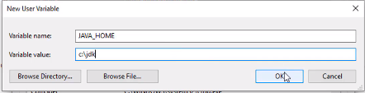
IN MEMORY COMPUTATION
Setting up the Environment
Step 5: Setting up Environment Variables

Slide 12
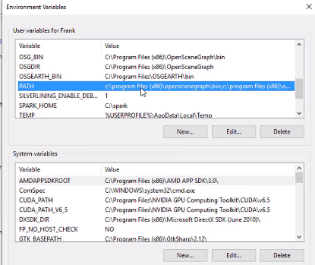
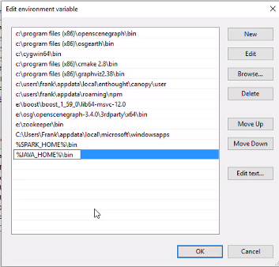
IN MEMORY COMPUTATION
Setting up the Environment

Slide 13
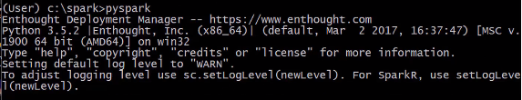
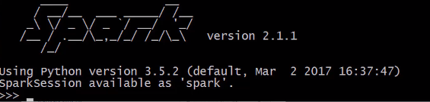
IN MEMORY COMPUTATION
Setting up the Environment
Step 6: Anaconda Prompt

Slide 14
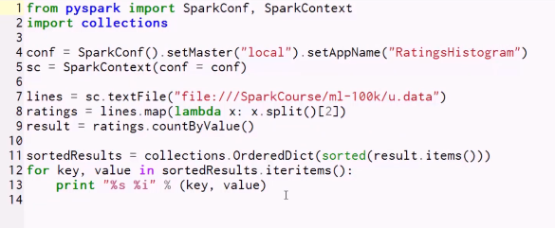
IN MEMORY COMPUTATION
First Spark Code

Slide 15
THANK YOU

